Slide 1
Lecture 11
Global phases
&
Receiver functions

Slide 2
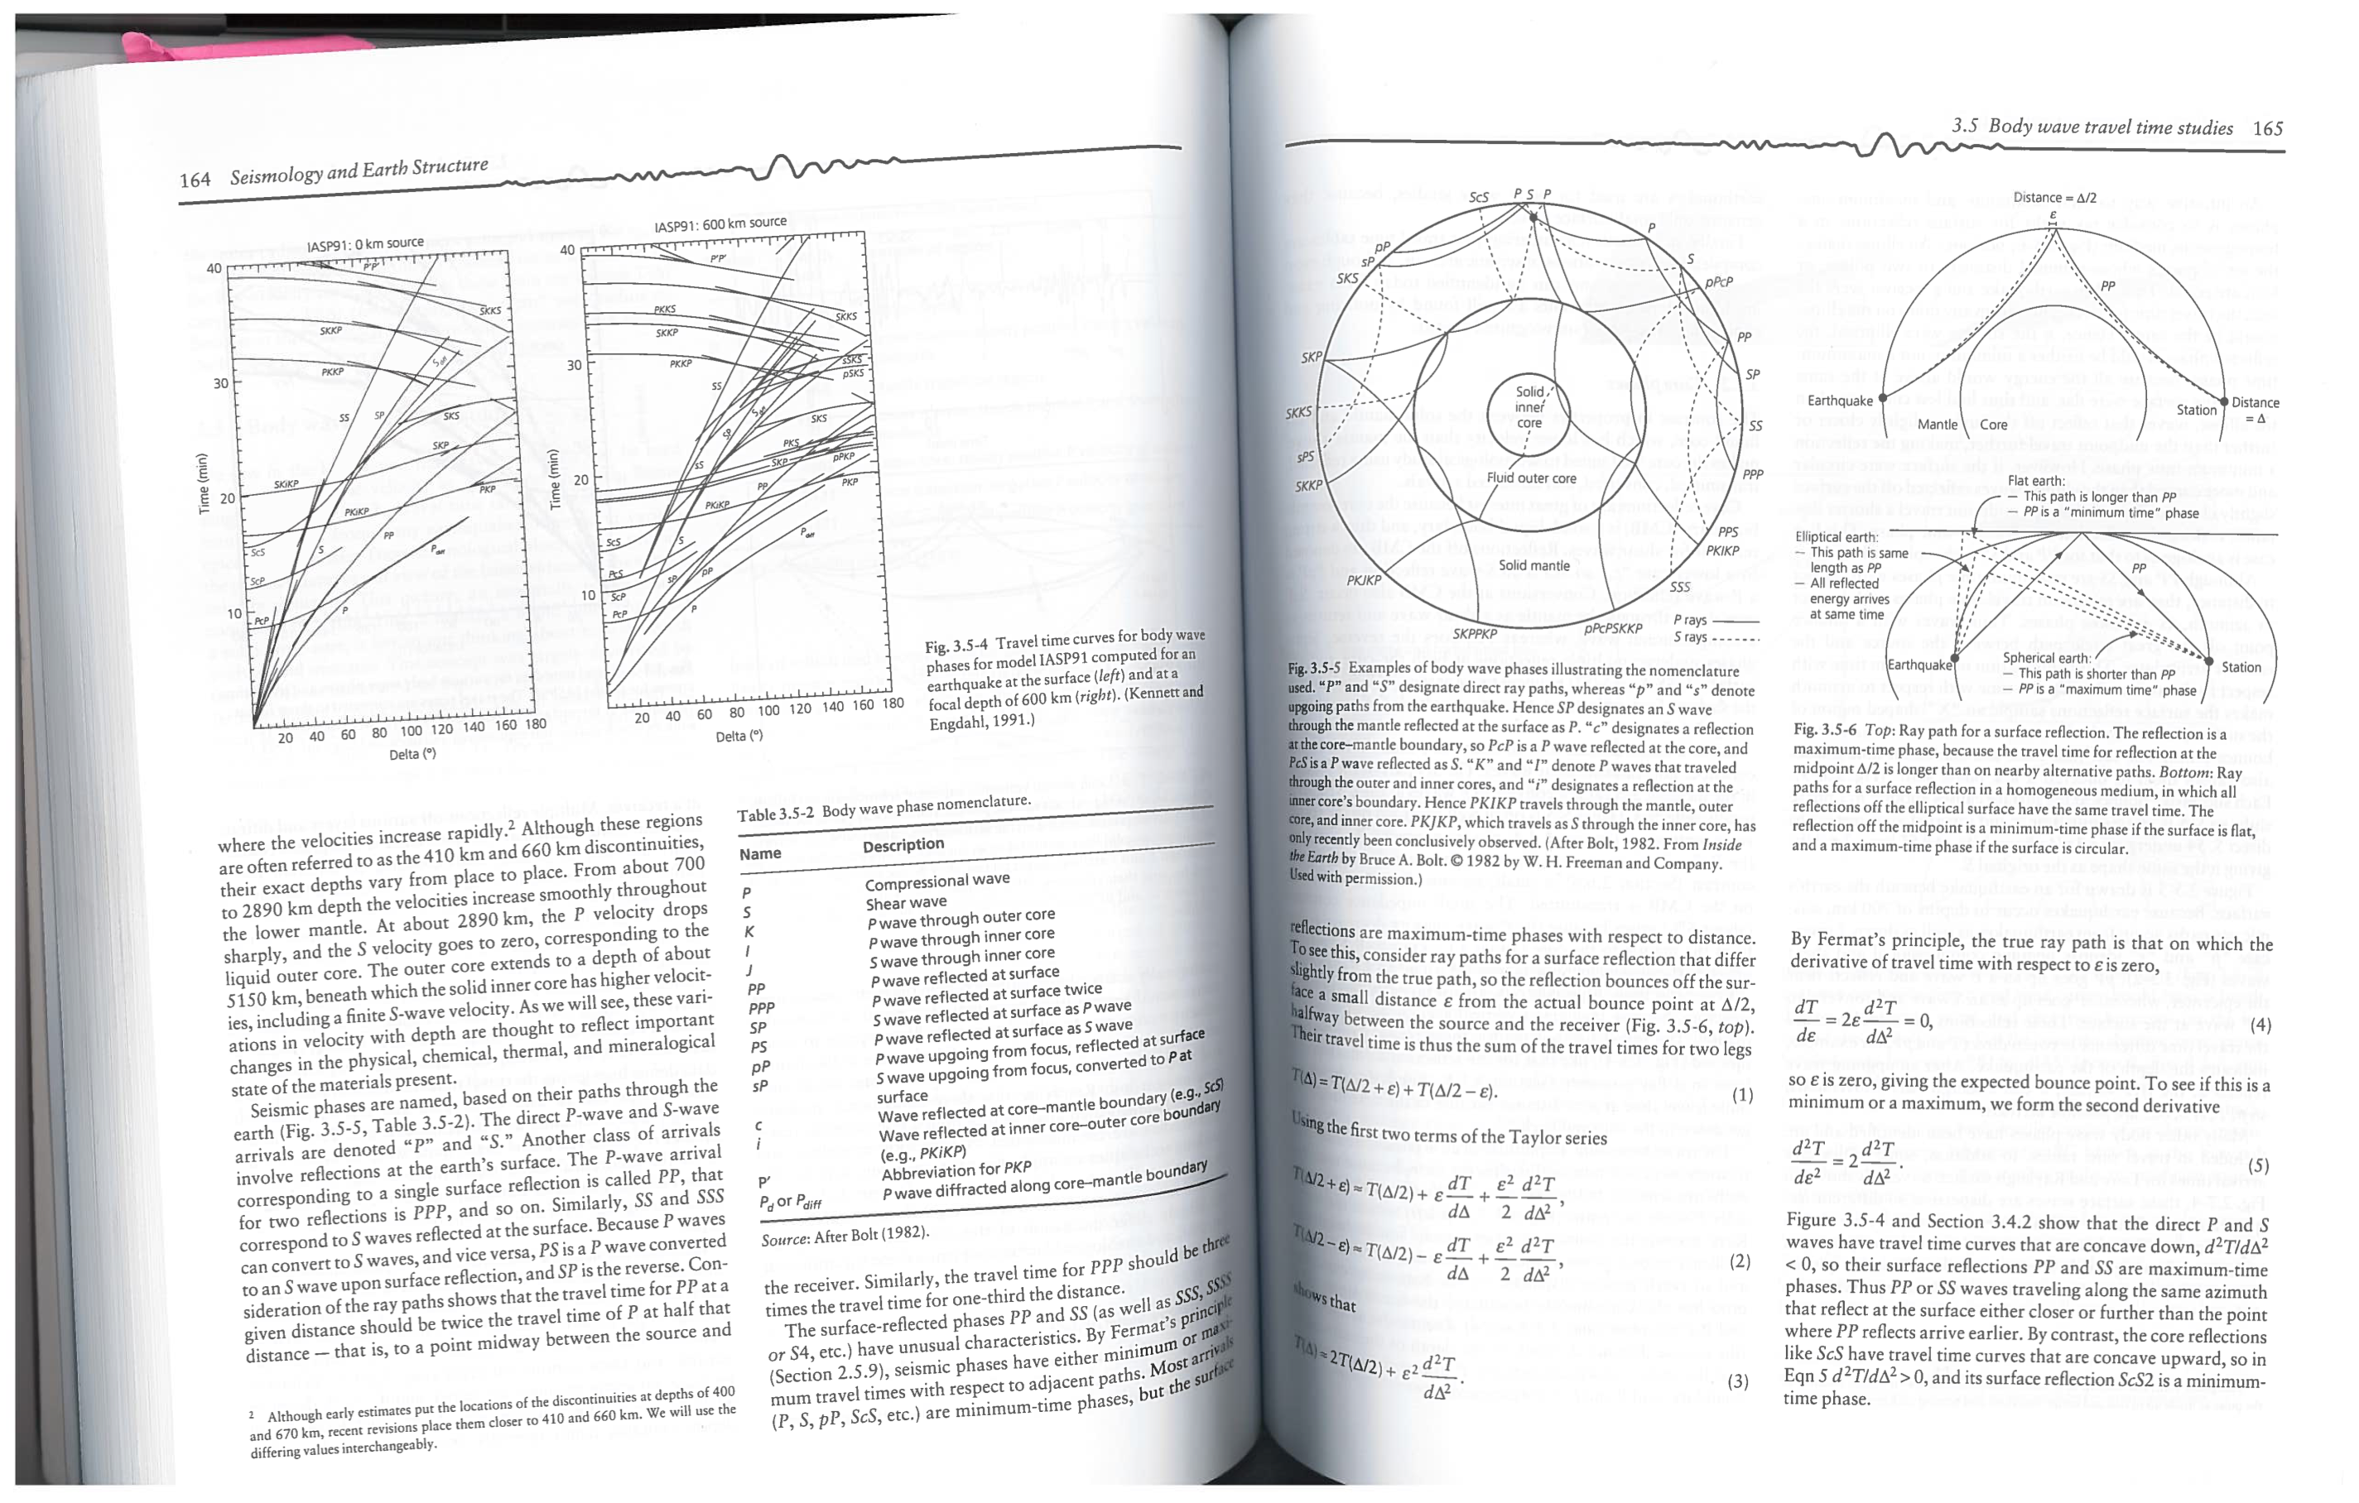

Slide 3
Check out real data
IRIS Global stacks

Slide 4
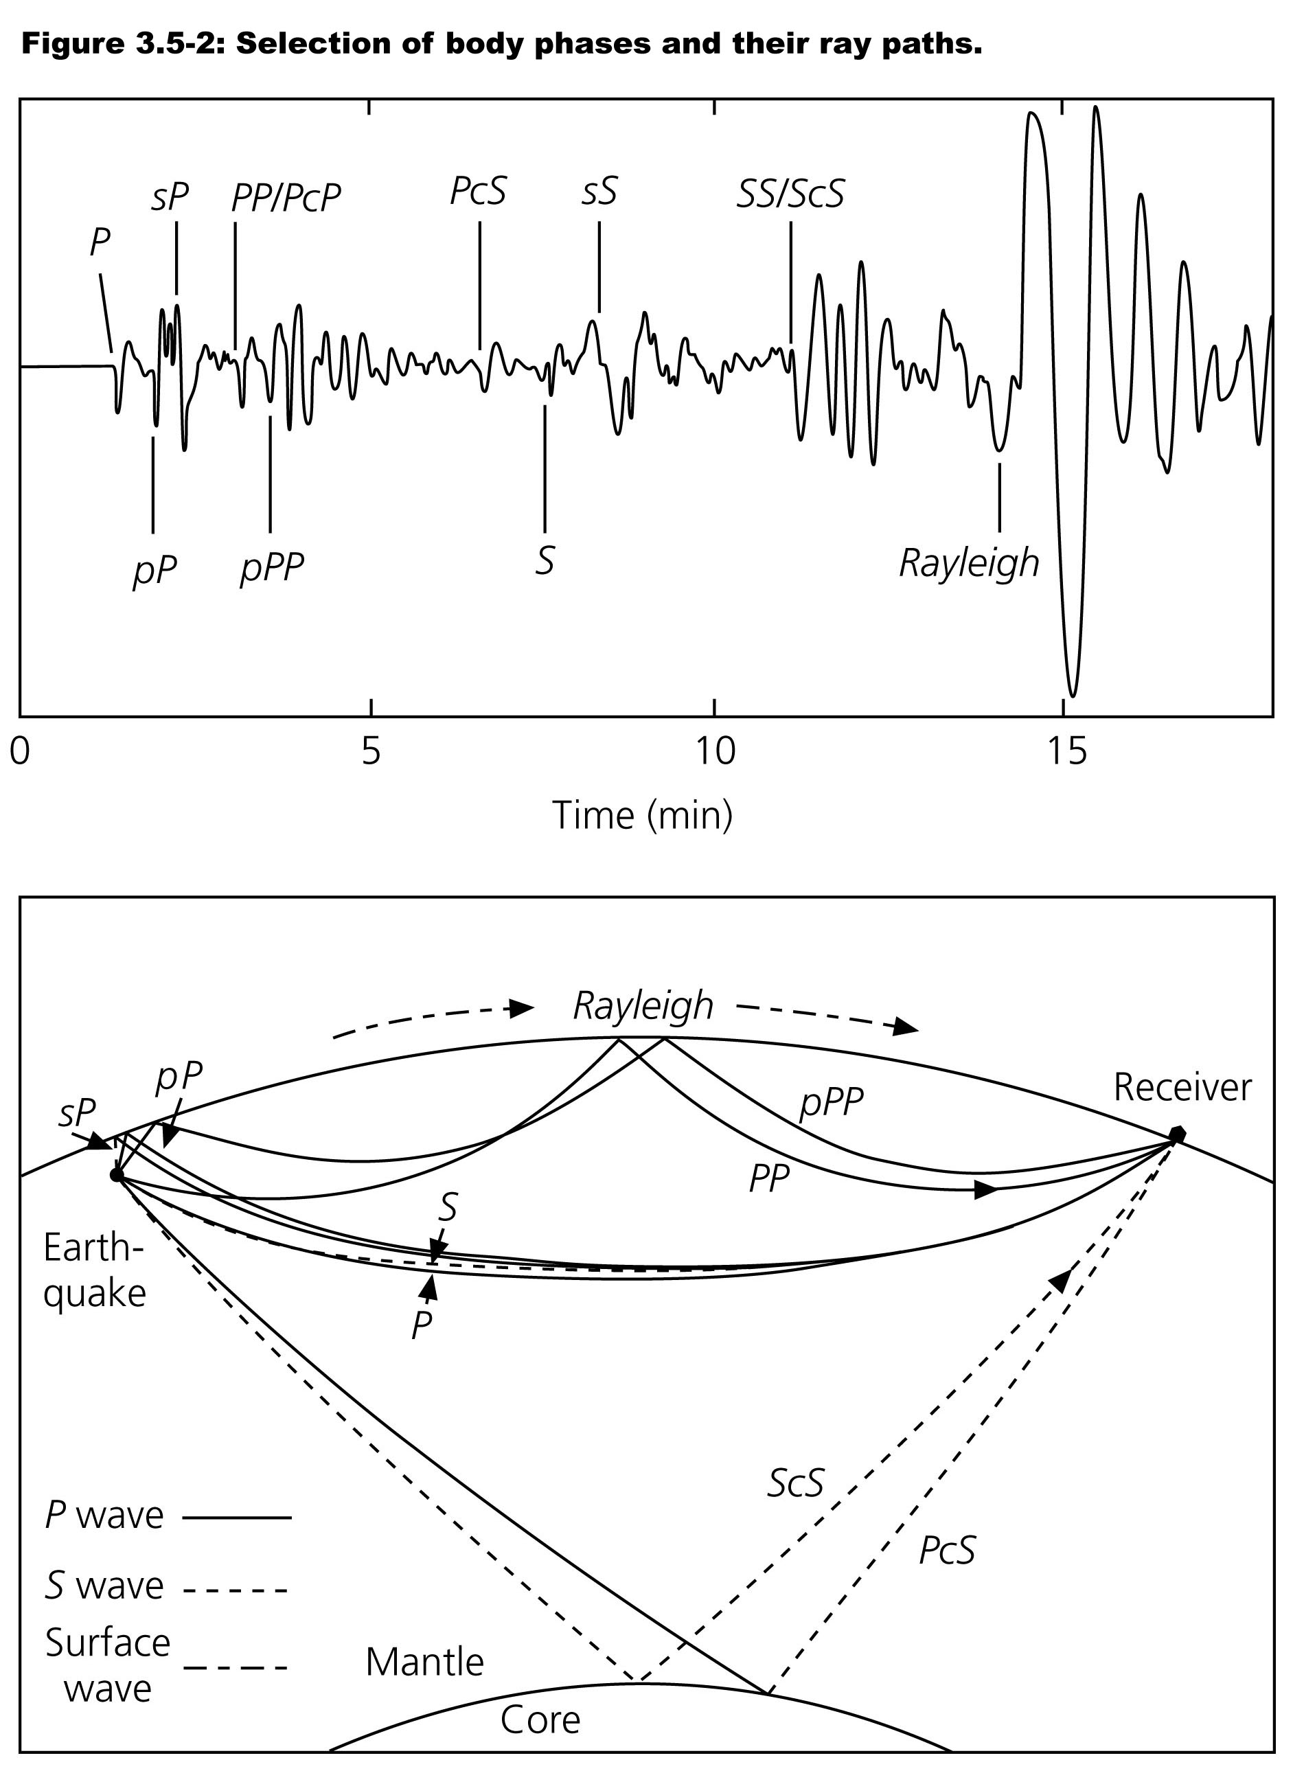
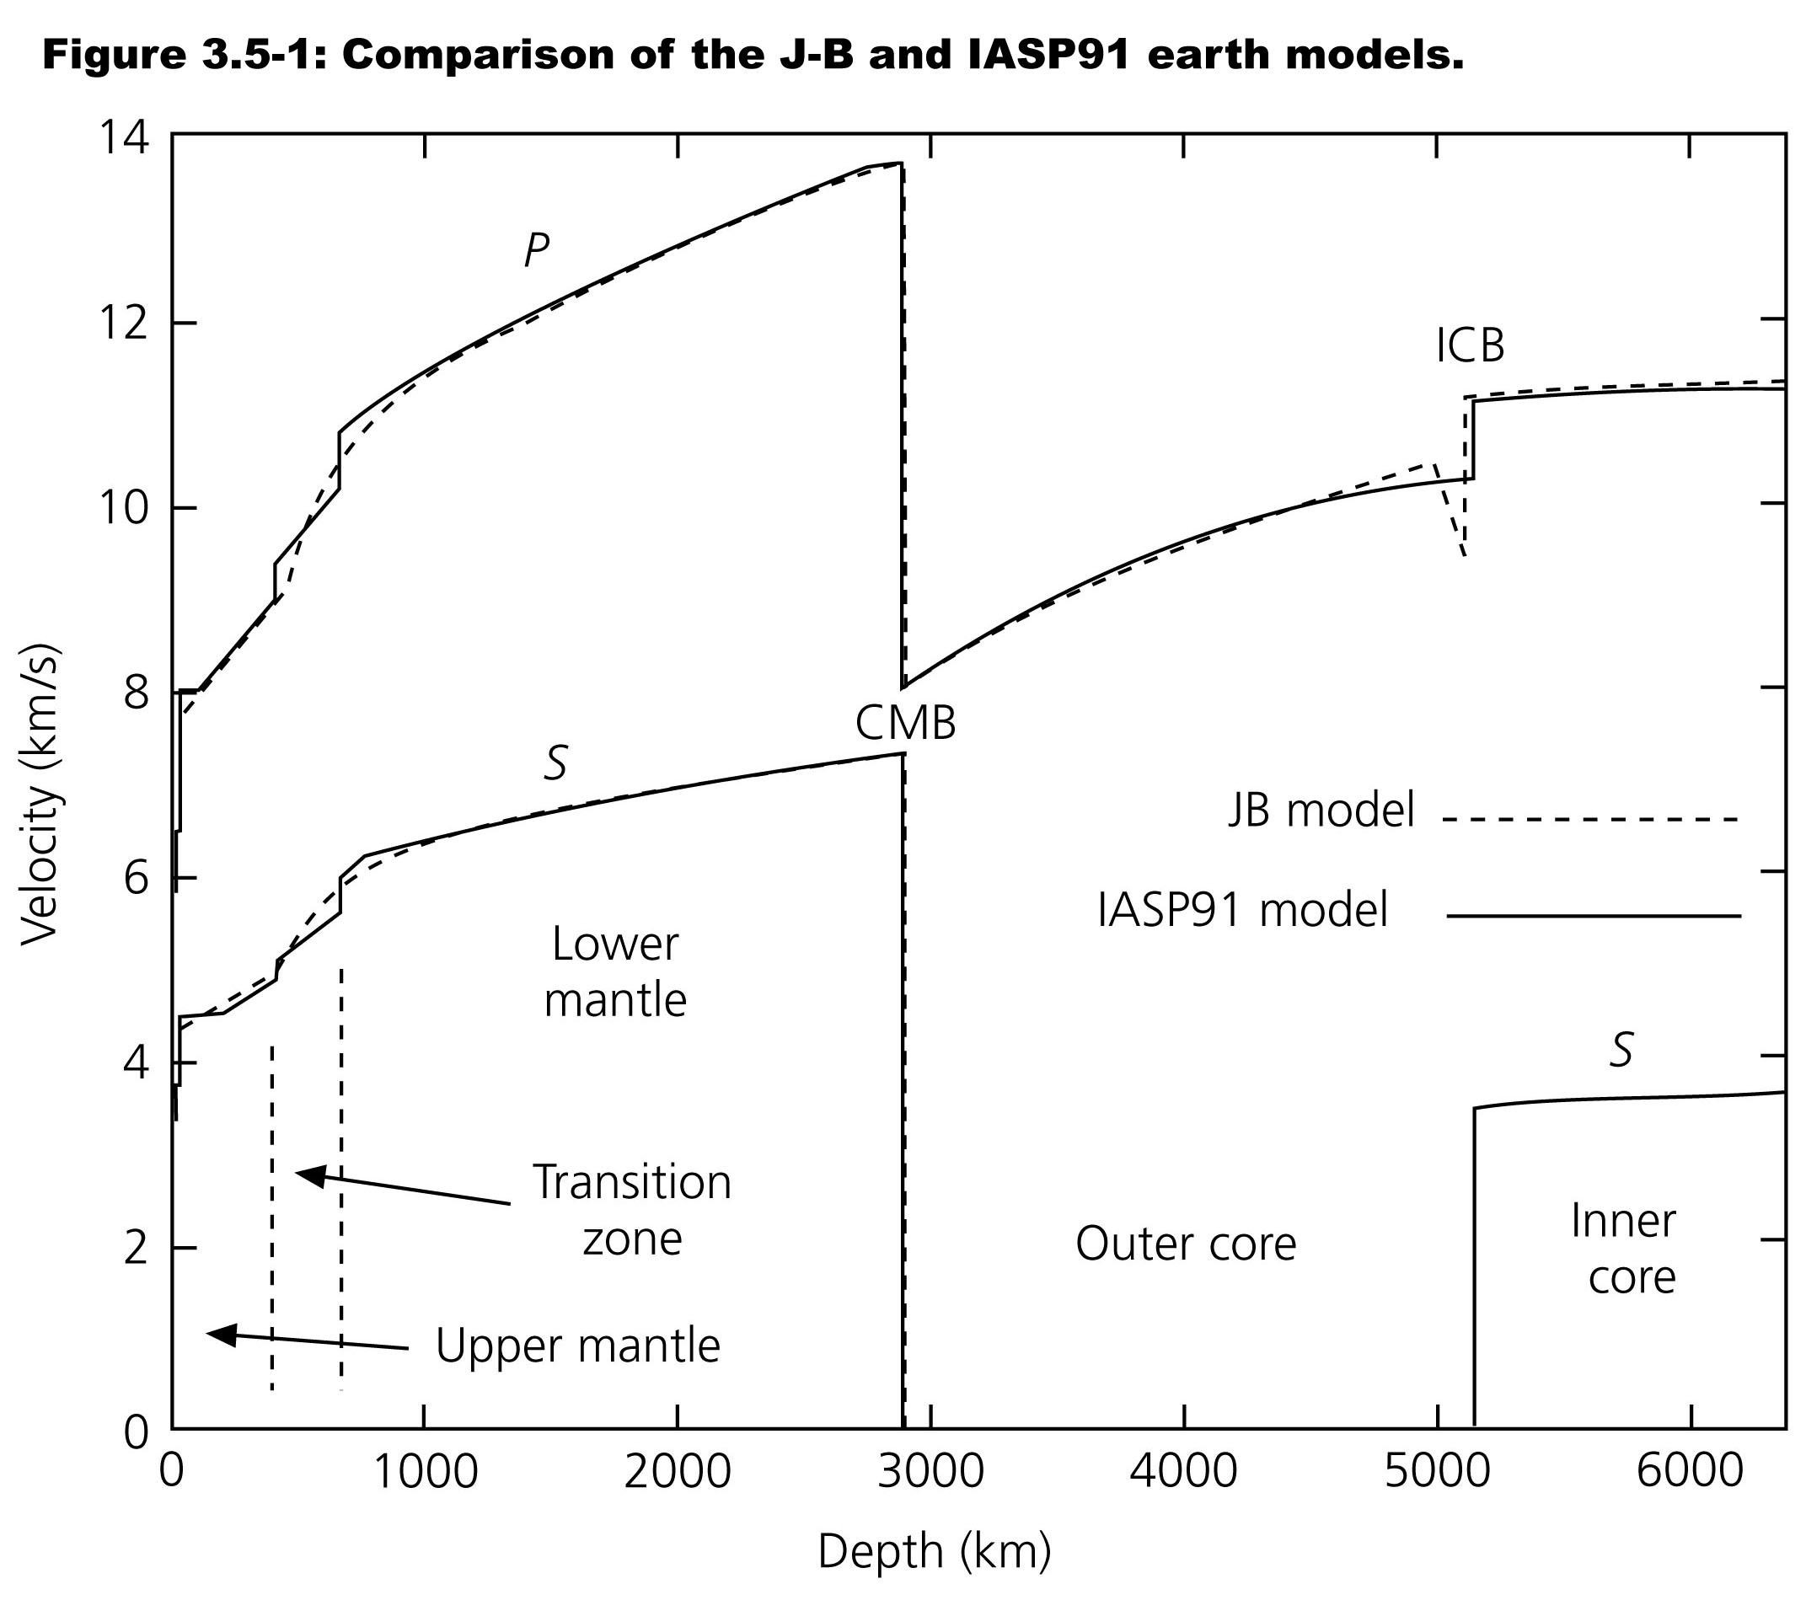
Earth Structure

Slide 5
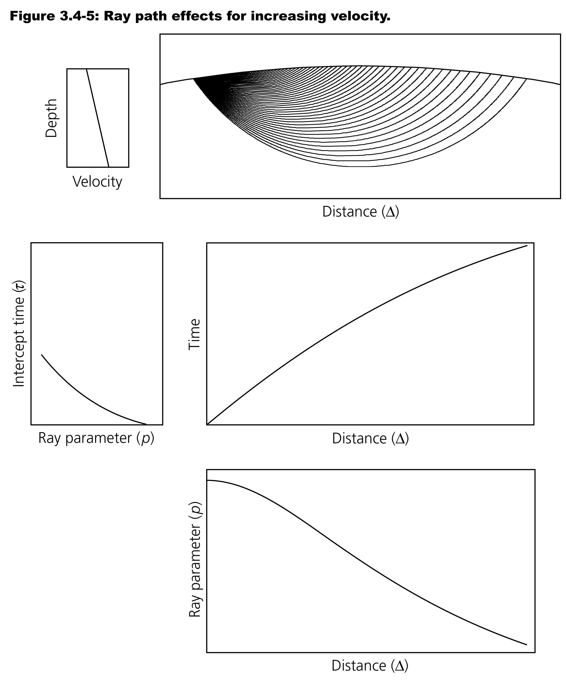
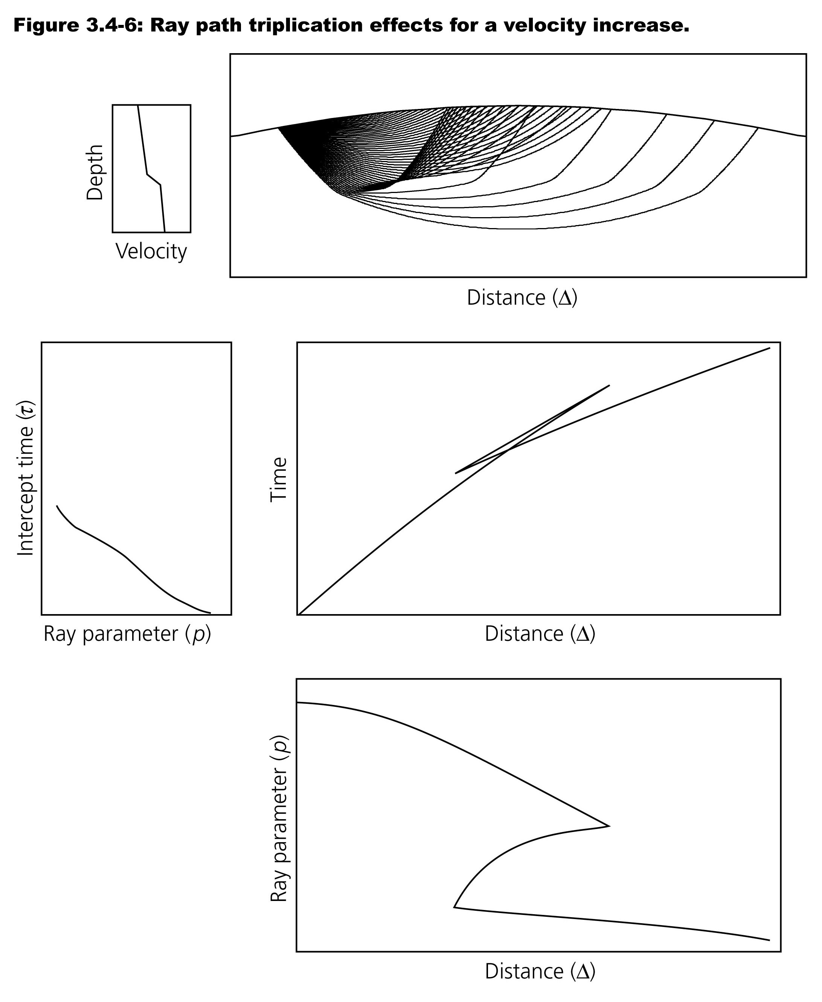

Slide 6
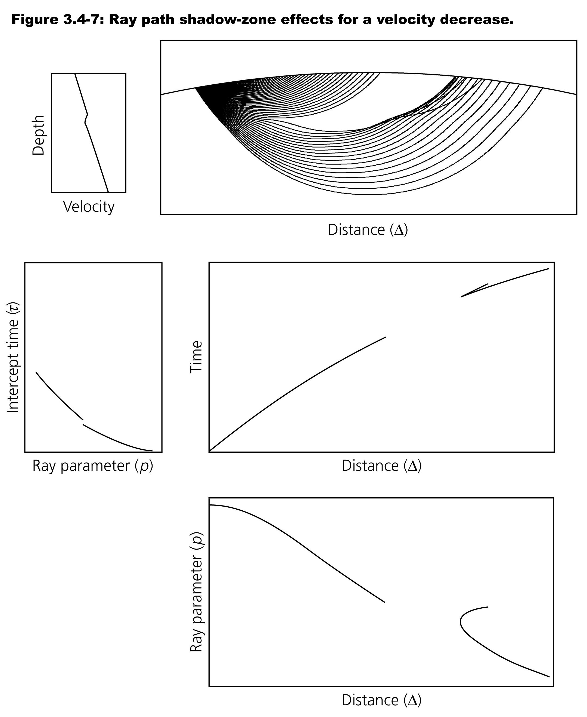
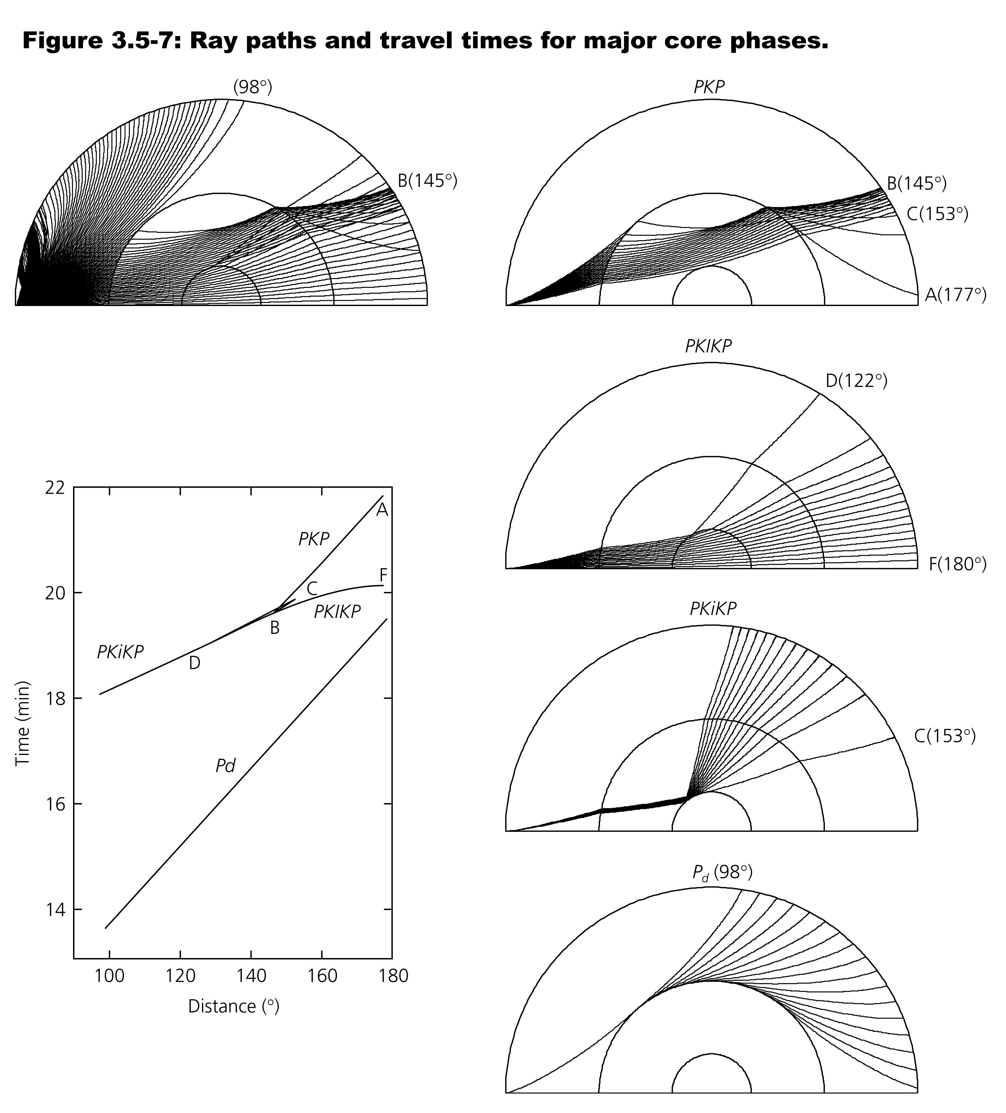

Slide 7
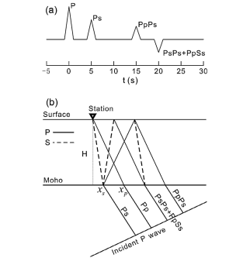
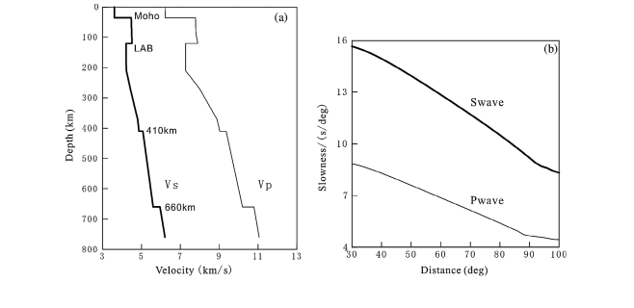
Receiver functions

Slide 8
http://eqseis.geosc.psu.edu/~cammon/HTML/RftnDocs/rftn01.html

Slide 9
Receiver function zone of sensitivity
The distance from the receiver sampled by a receiver function depends on how far back you look into the signal and how deep the velocity contrast of interest lies. The cartoon below shows the geometry of ray paths for an upper layer with a P-velocity of 6.00 km/sec and S-velocity of 3.43 km/s.
Xs = h * tan(asin(p*Vs))
Xp = h * tan(asin(p*Vp))
where h is the layer thickness, p is the ray parameter, and Vp and Vs are the P and S-velocity, respectively. If we assume a ray parameter of 0.06 s/km (P-wave from a shallow source about 60° away) and a thickness of 30 km, Xs = 6 km and Xp = 12 km. Because of its close sampling beneath the seismometer, studying the Ps can provide good lateral resolution of the crust mantle transition using events from different azimuths.

Slide 10
Water level deconvolution

Slide 11
Receiver function changes with azimuth
Depending on crustal structure, receiver functions change change with 1) azimuth and 2) source-receiver distance
IRIS has automated program to generate receiver functions
Real back-azimuth data here
http://www.iris.edu/hq/internship/uploads/ea6815333ffe5e3/fmsample_baz.jpg

Slide 12
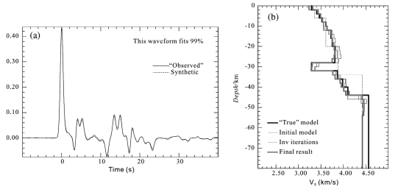
Receiver function inversion

Slide 13
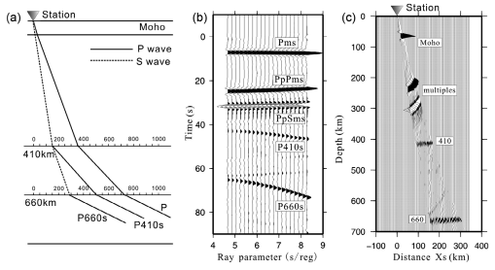
Receiver functions and ray parameters
Because ray parameter changes with distance between source and receiver, care must be taken when stacking
J Hu. et al. (2015)

